Slide 1
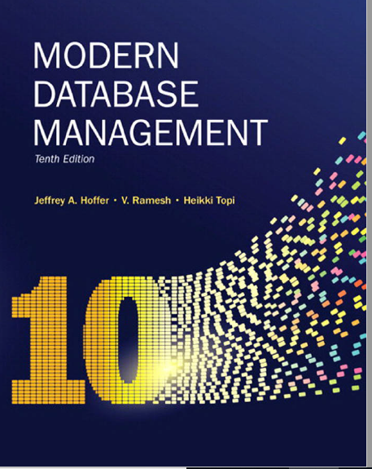
Chapter
- Persistent Stored Modules -

Slide 2
Objectives
Discuss SQL:200n standard and its extension of SQL-92
Understand stored procedures
User Defined Functions (UDFs)
Triggers

Slide 3
SQL:1999 and SQL:200N Enhancements/Extensions
User-defined data types (UDT)
Subclasses of standard types or an object type
Analytical functions (for OLAP)
CEILING, FLOOR, SQRT, RANK, DENSE_RANK, ROLLUP, CUBE, SAMPLE,
WINDOW–improved numerical analysis capabilities
New Data Types
BIGINT, MULTISET (collection), XML
CREATE TABLE LIKE–create a new table similar to an existing one
MERGE
Notes:
Create your own data types
Analytical functions great for calculating, moving averages, moving standard deviation, other statistical calculations
MERGE – doing INSERT, AND UPDATE at the same time

Slide 4
SQL:1999 and SQL:200N Enhancements/Extensions (cont.)
Persistent Stored Modules (SQL/PSM)
Capability to create and drop code modules
New statements:
CASE, IF, LOOP, FOR, WHILE, etc.
Makes SQL into a procedural language
Oracle has propriety version called PL/SQL, and Microsoft SQL Server has Transact/SQL
Notes:
Originally SQL was created as tool to retrieve and update and insert data into databases.
DBMS vendors saw a need in having procedural language within the db.
The standard was first introduced in SQL:96 standards. What can you do with PSM:
Variable declarations,
Control flow
Assignment of expressions
Exception handling
It defines stored procedures

Slide 5
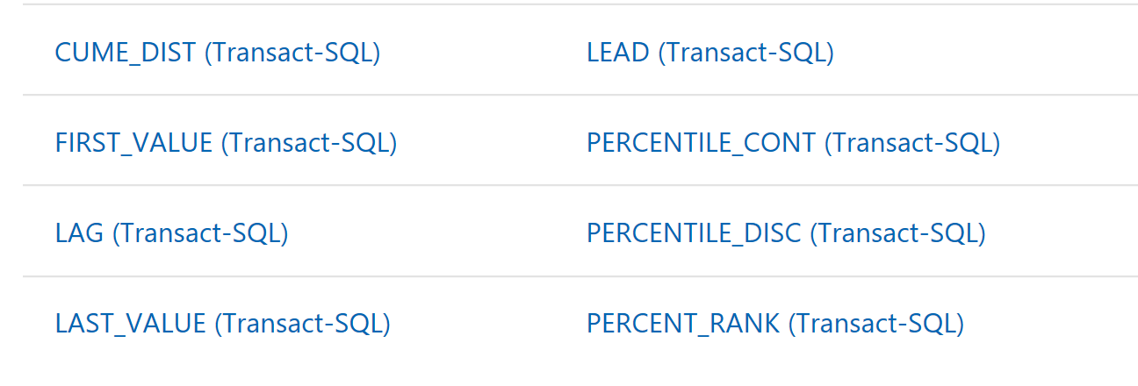
SQL Server Analytical Functions

Slide 6
Routines and Triggers
Routines
Program modules that execute on demand
Functions–routines that return values and take input parameters
Procedures–routines that do not return values and can take input or output parameters
Triggers–routines that execute in response to a database event (INSERT, UPDATE, or DELETE)
Notes:
Routine is a block of code that does something, much like other programing languages such as java or C++
The tools available in those languages are also available in databases.
There is 3 basic types of routines in the database world:
Function, routine that takes input values and return values back
Stored procedures – returns that cannot return values but take input parameters
Triggers – routines that execute when an even occurs! For example a delete of a table

Slide 7
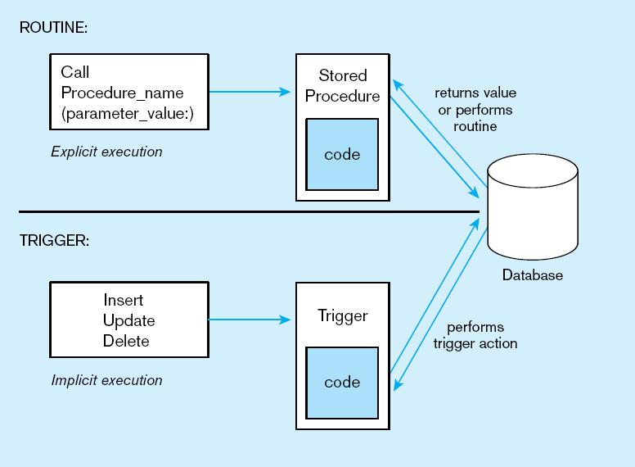
Figure7-11Triggers contrasted with stored procedures
Procedures are called explicitly
Triggers are event-driven
Source: adapted from Mullins, 1995.
Notes:
Procedures are called explicitly.
Triggers are called when a DML statement is executed

Slide 8
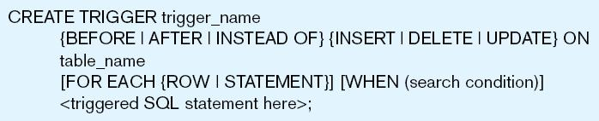
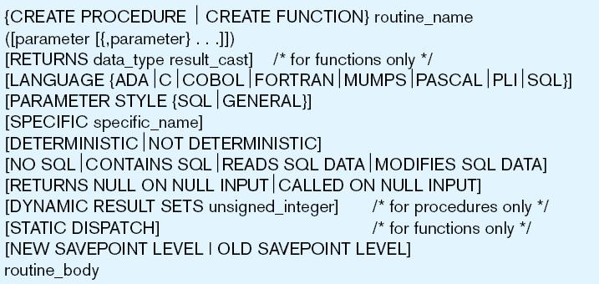
Figure 7-12 Simplified trigger syntax, SQL:200n
Figure 7-13 Syntax for creating a routine, SQL:200n
Notes:
INSTEAD OF triggers skips the executition.

Slide 9
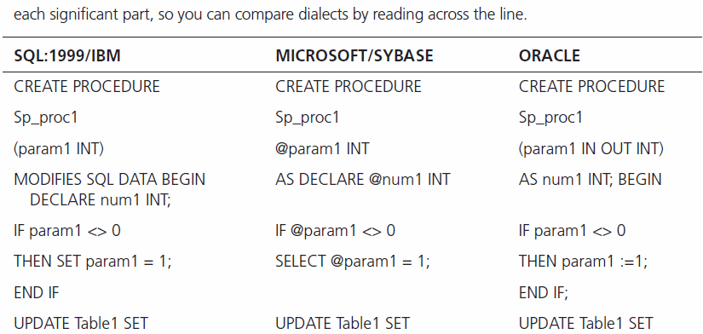
Notes:
The syntax varies from language to language/ the structure is very similar!

Slide 10
Embedded and Dynamic SQL
Embedded SQL
Including hard-coded SQL statements in a program written in another language such as C or Java
Dynamic SQL
Ability for an application program to generate SQL code on the fly, as the application is running
Notes:
They are not great practice because of security risks involved with input parameters

Slide 11
Stored Procedures
Parameters
Input parameters
Output parameters
Options for results
Via Output parameters ( single value)
Result set ( multiple rows)

Slide 12
Advantages of Stored Procedures
Separations of business rules
Utilization of set-based processing
Performance
Security
Maintainability
Notes:
Separations of business rules – instead of having business rules in separate lines of code, and separate files, SP consolidates and separate business rules
Utilization of set processing – instead of looping through records in the application
Performance – optimization plans cashed
Security - helps with sql injection
Maintainability
- tracking of changes and dependencies on any schema changes becomes easy

Slide 13
Stored Procedure Syntax
-- Transact-SQL Syntax for Stored Procedures in SQL Server and Azure SQL Database
CREATE [ OR ALTER ] { PROC | PROCEDURE }
[schema_name.] procedure_name [ ; number ]
[ { @parameter [ type_schema_name. ] data_type }
[ VARYING ] [ = default ] [ OUT | OUTPUT | [READONLY]
] [ ,...n ]
[ WITH <procedure_option> [ ,...n ] ]
[ FOR REPLICATION ]
AS { [ BEGIN ] sql_statement [;] [ ...n ] [ END ] }
[;]
<procedure_option> ::=
[ ENCRYPTION ]
[ RECOMPILE ]
[ EXECUTE AS Clause ]

Slide 14
Example of SQL Server Stored Procedures
Examples in the “Stored Procedures and Functions” word document
Notes:
--PRINT DOC
ALTER PROCEDURE GetEmployees @depar_no varchar(5)
AS
BEGIN
SELECT * FROM employee
WHERE dept_no =@depar_no
END
EXEC GetEmployees 'D1’
ALTER PROCEDURE ChangeEmployeeDept @emp_no INT, @new_depar_no varchar(5)
AS
BEGIN
UPDATE employee set dept_no =@new_depar_no
WHERE emp_no = @emp_no
END
EXEC ChangeEmployeeDept 15000, 'D1’
EXEC ChangeEmployeeDept @emp_no= 15000, @new_depar_no='D1'

Slide 15
Triggers
Triggers – procedural code that is fired automatically when events occur in the database.
Triggers cannot be invoked directly
Trigger are associated with events such as DML commands such as UPDATE, DELETE, INSERT

Slide 16
Benefits of Triggers
Data integrity checking
Auditing and logging
Derived column generation

Slide 17
Types of Triggers
AFTER/BEFORE
UPDATE
DELETE
INSERT
INSTEAD OF TRIGGER
DMBS skips the DML executed.

Slide 18
Trigger Example
Create an Audi trail table to store historical records for Department table
Create a trigger that captures UPDATES in the department table, and saves changes to the historical table
Example in Trigger.sql document

